Slide 1
Variations
eLearning module
  Recall of concepts
  Application/conversation emphasis
No eLearning module
  Introducing concepts for the first time
  Content emphasis
  Potential second session for application?
Notes:
This virtual session has been designed to be delivered together with the eLearning module The Basics of Insights Discovery. Participants should be sent the link to the eLearning module and asked to complete it (20-30 minutes) prior to attending the live virtual session. The facilitator (or team lead) may need to follow up with participants prior to the virtual session to ensure they have completed the eLearning module prior to the session in order to maximise the application that can occur. Another option would be for the facilitator to block an additional 30 minutes to the session time and ask participants to go through the eLearning module individually at that time before joining together as a team to apply the concepts.
Where all participants have completed the eLearning module, the live learning session involves a recall of the core concepts of Perception, Colour Energies, and Jungian Preferences with the chance to explore how these concepts show up in the team or business context; followed by an explanation and exploring of the profile, graphs, recognising type, and adapting to connect. The notes in this slide deck provide guidance on how to connect the learning from the eModule with the content and application exercises here. For more support with this approach, see the two-hour agenda for a session that builds on the eLearning module.
Where all or none of the participants complete the eLearning module, the live learning session will need to focus more on introducing the core concepts to participants. It may be wise to schedule a second session that can focus on the application of the concepts to the team and action planning. Facilitators may need to bring in more content and knowledge than is in the facilitator notes for these slides. We refer you to the Theory (1) and Preparing to Deliver (2) practitioner guides from your Insights Discovery Accreditation for additional content support. See the agenda for running virtual Insights Discovery in 2 90-minute sessions for guidance on how to run a session that does not reference the eLearning module.

Slide 2
Client name or session here
Facilitator name and date

Slide 3
Facilitator preparation
Decide objectives/learning outcomes
Decide which exercises to leave in/take out given objectives and timing
Prepare card deck – select four card from each colour that present a broad definition
Decide profile questions for breakout room sharing, and group composition
Insert Team Wheel, if applicable
If using breakout rooms for adapting to connect, decide on groups
Identify any post-session assignments or next steps

Slide 4
Insights Discovery: An Introduction
Beginning the journey …
Notes:
Gathering
As participants are gathering, remind participants about the eLearning that they completed and ask them which colour energy(ies) they think they are bringing with them to the session today and why, or what that might look like for them.
Ask participants to have some paper and a pencil with them during the session.
Alternate Icebreaker
Ask participants to put their name in the chat with an adjective that describes them AND starts with the same letter that their name starts with (e.g. Crazy Carrie, or Jovial Josh)
Getting started
Share with the group a little bit about yourself Why are you here? Do you have a
compelling (yet quick!) personal story about the impact of Insights Discovery that you can share? Consider the kind of energy you are putting into the room and the expectations you are setting.

Slide 5
Your webinar host today
Introduce yourself
Insert this slide with photo if not using webcam/live camera feed
Notes:
OPTIONAL SLIDE:
As the facilitator of this virtual session, it can be helpful for your participants to have a visual of you. Particularly if they do not already know you.
Use this space to add a photo and perhaps a bit of a bio to set the stage…

Slide 6
Using (Platform Name)
Add in information necessary to orient participants to
the platform tools you will be using during the session:
  Audio set up
  Chat
  Status updates
  Whiteboards
  Polls
  Breakout rooms
  Etc.
Notes:
Add in one or more slides here that orients your participants to the virtual delivery platform you are using, and the tools they will need in order to actively engage with the session.

Slide 7
Insights Discovery
Focuses on improving personal, interpersonal and team effectiveness
Provides a common language about what drives our behaviour in the workplace
Grounded in the work of psychologist Carl Jung

Slide 8
Objectives for today
Notes:
Add Objectives for the Session

Slide 9
Learning outcomes
Notes:
Add Learning Outcomes for the session

Slide 10
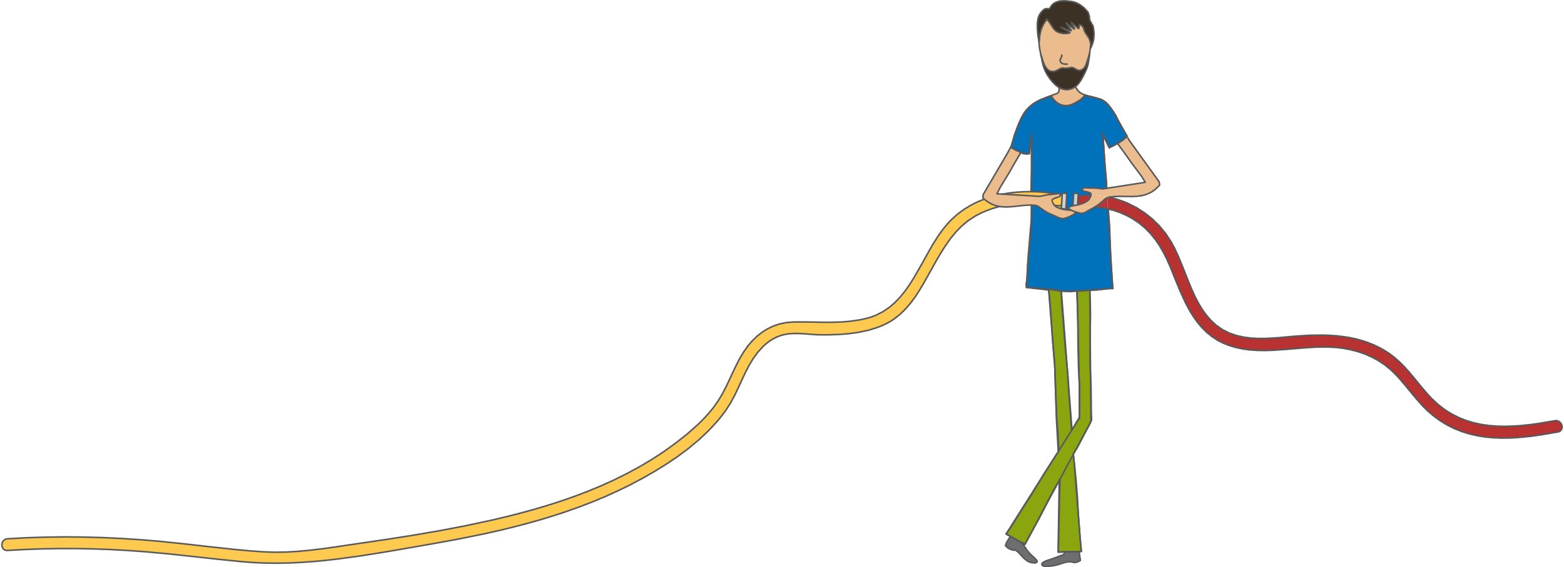
Today is about connections
Who do you need to connect with more?
Notes:
Today is about connections – Insights Discovery and personal effectiveness
are about connections – specifically improving them! Have you ever wanted to connect with someone, or needed to, and noticed that their different personal style can at times prevent you from establishing a good connection with them?
With a little effort, we can make better connections more often.
Ask your participants to turn to ‘pick their person’ i.e. write down the name of someone in their life who they would like to improve their relationship with.

Slide 11
Who
am I?
Notes:
Ask participants to answer the question ten times, by writing the prompt "I am..." And then finishing the statement.
Ask participants to share some of their answers in the chat so that we may get to know who is in the room.
Ask the group what they notice about the answers (e.g. some may be about roles, some about characteristics, some more surface level, some deeper)
Today's session explores additional aspects of who we are.

Slide 12

The steps to personal effectiveness
Step 3
Learn how to adapt your behaviour to interact more effectively with others
Step 1
Explore and discover more about yourself
Step 4
Take action and put your learning into practice
Step 2
Learn how to recognise and appreciate others’ differences
Notes:
Share the four steps to personal effectiveness, that we will be taking in this process. These are essentially the objectives for the day.

Slide 13
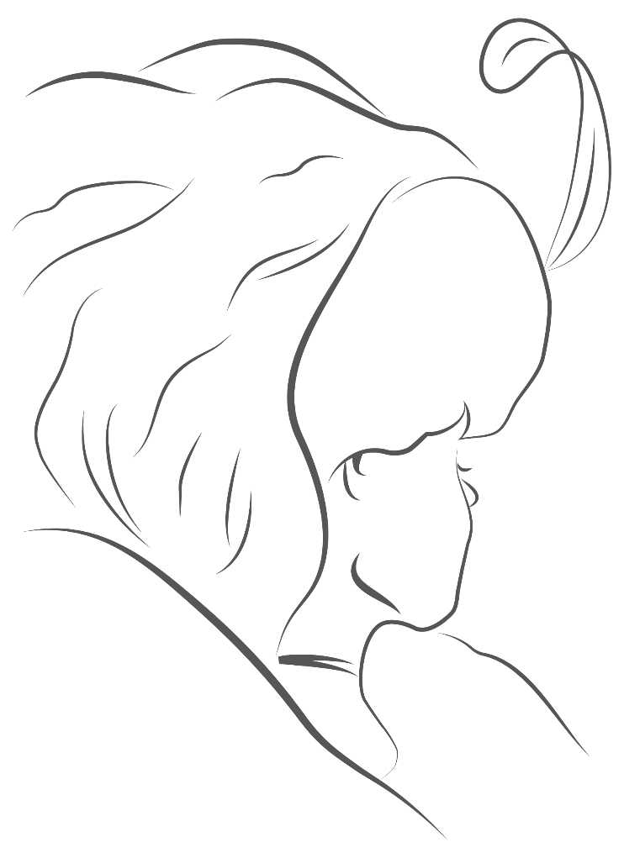
Perception
You will see the world differently from the way other people see it.
Perceptions can change, with awareness.
Notes:
Start with a general discussion about perception. How would you define perception? Where do perceptions come from?
[Type responses in the chat]
Click to reveal first sentence.​
The eLearning module defined perception as “the way in which we regard, understand, and interpret the world” indicating that “Our perceptions are unique.”​
​
The eLearning module used the example of the Old Woman/Young Woman to demonstrate that there is rarely “one right way” to perceive something.​
POLL: How many see the young lady FIRST when looking at this image? How about the old lady FIRST? Can you see both now? (If not, let us know and we’ll help you to see both after the session)​
​
CHAT/SPEAK: What are some examples of personal/common perceptions related to your role, this team, or our organization?​
(Examples: This is a large/small team. Best team to work on! That was a long/short meeting. The time to delivery of our last deliverable was short/long, or easy/hard. The leaders at this company are transparent/secretive.)​
​
Click to reveal second sentence.​
CHAT: What is an example of a time when you changed a perception? How did that happen?​

Slide 14

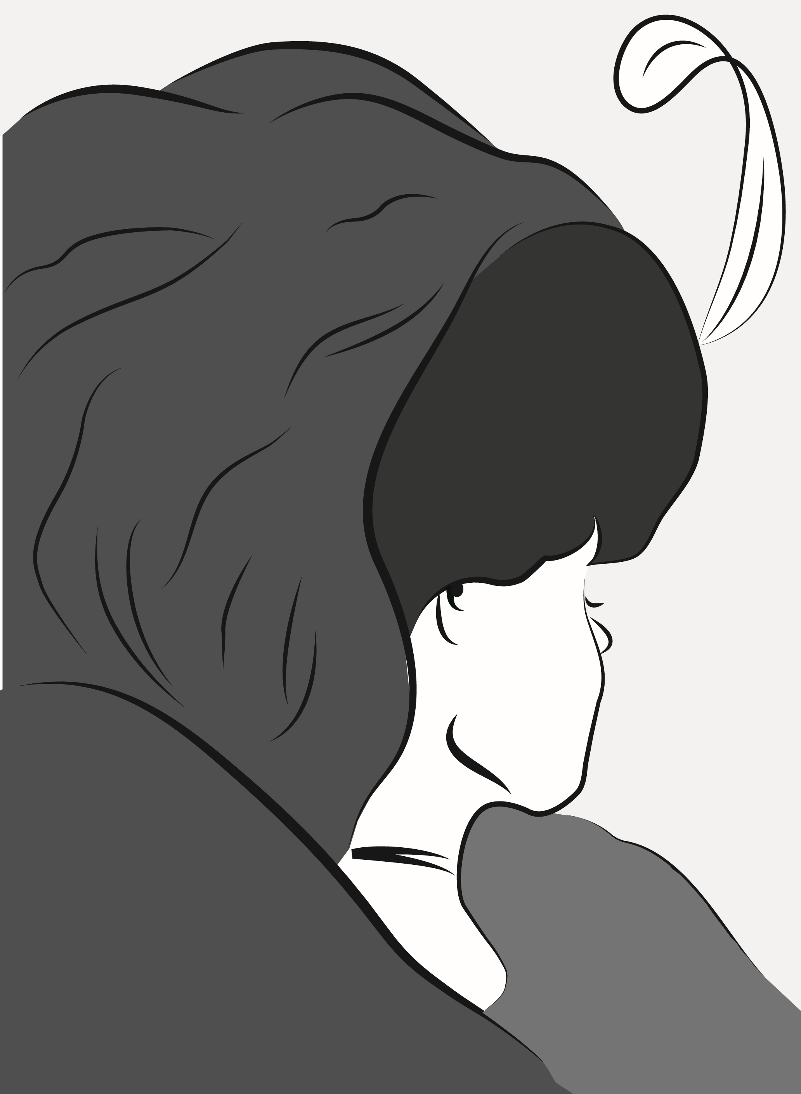
Perception
Notes:
Showing these two slightly differently emphasized versions of the image can help people to be able to see both Young Lady and Old Lady
Optional activity (if not using eLearning module as prework):
Show each “lady” and use the 4 box tool or chat boxes to have participants type their answers to the questions. Comment on similarities and differences, with the takeaway being to notice the stories that we all make up based on our own perceptions.
PRODUCER: Add Old Lady / Young Lady questions
“How old is she?”
“Where is she from?
“What has her life been like?”
“How would you approach or communicate with her?”

Slide 15
Perception scenario
Your group has a new manager and you have joined the first virtual team meeting led by this person. The manager (your boss) greeted everyone else on the call by name, but did not greet you.
What are your immediate thoughts and feelings?
Notes:
Say: Often perceptions arise from situations we experience, like this one.
CHAT responses to the question.
Comment on the variety of answers. Typically they range from "I wouldn't notice as I wasn’t keeping track" to "What a jerk" with others saying "Maybe he doesn’t know my name, or forgot; or the time was crunched so he dived into the meeting." If you don't hear this range of answers prompt people who may be thinking something different to share it.

Slide 16
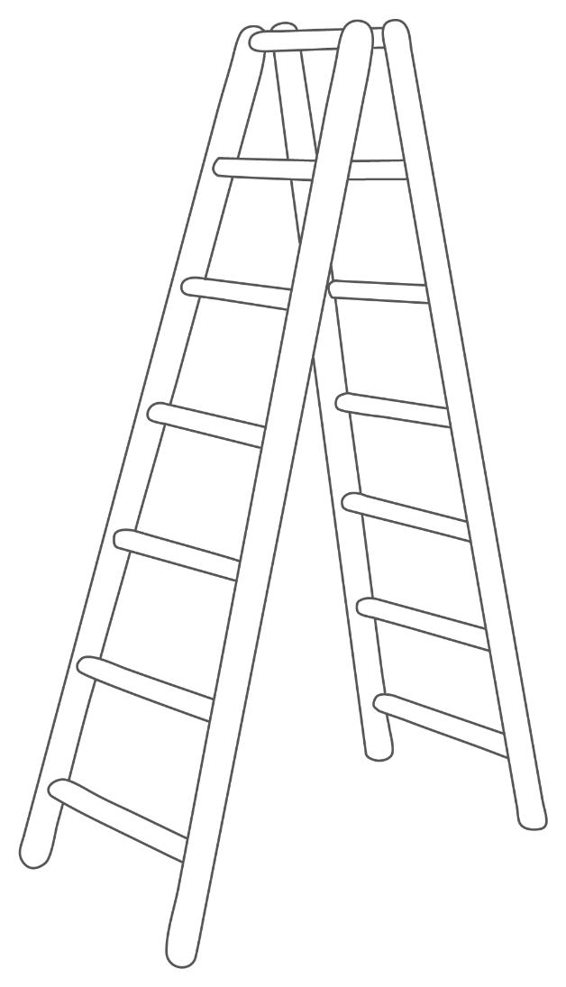
The ladder of perception
Actions I took
Beliefs I formed
Emotional and physical responses
Logical conclusions I drew
Interpretations and meanings I gave
Value judgements I made
My perception (selected data)
The event (as a camera would capture it)
Notes:
Say: The ladder of perception was introduced in the elearning module as a way to understand how perceptions are formed.
Use the scenario of the manager from the previous slide, or a personal example to demonstrate the process of going up each rung of the ladder. Mention the ladder as a good tool to help identify differences in perception and to intentionally back down the ladder to gain understanding and alignment with another perspective.
Ask participants to consider when they have gone up their ladder.
Say: The concept of Perception is very important for our self-awareness and for our ability to understand and connect with others.
Say (Thought exercise): Think about the individual you identified at the beginning whom you would like to have a stronger connection with. Have there been situations where the two of you have had different perceptions about something? Has that been a positive experience, or a challenging one? Can you identify which rung of the ladder you went your separate ways?
(Optional breakout: Share examples of ladder stories, or discuss varying perceptions in the team)

Slide 17
The Insights Discovery Colour Energies
Notes:
The eLearning module introduced you to the concept of psychological preferences as one factor that influences our perceptions. Insights has named these the Insights Discovery colour energies.

Slide 18
^{cheerful}
^{challenging}
^{assertive}
^{reflective}
^{concise}
^{caring}
^{enthusiastic}
^{determined}
^{factual}
^{well-argued}
^{reliable}
^{firm}
^{accommodating}
^{objective}
^{fun}
^{active}
^{steady}
^{sensitive}
^{accurate}
^{tactful}
^{driving}
^{constant}
^{structured}
^{harmonious}
^{purposeful}
^{cautious}
^{amenable}
^{strong-willed}
^{convincing}
^{calculating}
^{persuasive}
^{diplomatic}
^{patient}
^{influencing}
^{logical}
^{sociable}
^{outgoing}
^{courageous}
^{forceful}
^{optimistic}
^{co-operative}
^{conventional}
^{mobile}
^{friendly}
^{stable}
^{consistent}
^{decisive}
^{correct}
^{loyal}
^{calm}
^{daring}
^{analytical}
^{engaging}
^{impulsive}
^{realistic}
^{exact}
Notes:
Say: The words on the screen represent a variety of characteristics a person might have. Take a look at these words and write down six that describe you well.

Slide 19
^{cheerful}
^{challenging}
^{assertive}
^{reflective}
^{concise}
^{caring}
^{enthusiastic}
^{determined}
^{factual}
^{well-argued}
^{reliable}
^{firm}
^{accommodating}
^{objective}
^{fun}
^{active}
^{steady}
^{sensitive}
^{accurate}
^{tactful}
^{driving}
^{constant}
^{structured}
^{harmonious}
^{purposeful}
^{cautious}
^{amenable}
^{strong-willed}
^{convincing}
^{calculating}
^{persuasive}
^{diplomatic}
^{patient}
^{influencing}
^{logical}
^{sociable}
^{outgoing}
^{courageous}
^{forceful}
^{optimistic}
^{co-operative}
^{conventional}
^{mobile}
^{friendly}
^{stable}
^{consistent}
^{decisive}
^{correct}
^{loyal}
^{calm}
^{daring}
^{analytical}
^{engaging}
^{impulsive}
^{realistic}
^{exact}
Notes:
As you move to the slide with the colourful words, ask if they notice any colour themes on the words that they were drawn to.
Say: Now that colour has been added to the words, note which colour is associated with each of the words you wrote down in the previous exercise, by using R/Y/G/B
Say: Did you select more of any particular colour than another? Does this match with which colour energies you identified with most in the eLearning module?
Say: Think back to the Who Am I exercise, (and to the name/adjective icebreaker, if you used it). Are any of the coloured words here similar to what you chose for those other exercises?

Slide 20

Finger constantly on the pulse.
Responsible, methodical and works well with facts and figures.
Makes friends quickly and easily.
Sensitive to the needs of the group.
Logical thinker
Can gain personal fulfilment through helping others
Can generate
fast results by prioritising well and taking action
Infectious enthusiasm
Notes:
Say: We have seen individual words that represent each of the colour energies. Now lets look at some statements to help round out our understanding of each of the four colour energies. Remember that we all use all four colour energies, but we are likely to have a preference for one or more above the others.
Say: Read the first four statements. Type in the chat the order of the colour energies, from most like you to least like you.
Say: Repeat for the second four statements. Is your colour order similar or different?
When working with a team:
Say: Are there any of these statements that you believe fits one of your colleagues who is also in this session? Type in the chat box the name of the colleague and the statement.
Say: How does it feel to receive that feedback? (Positive, as these are all strength statements).

Slide 21
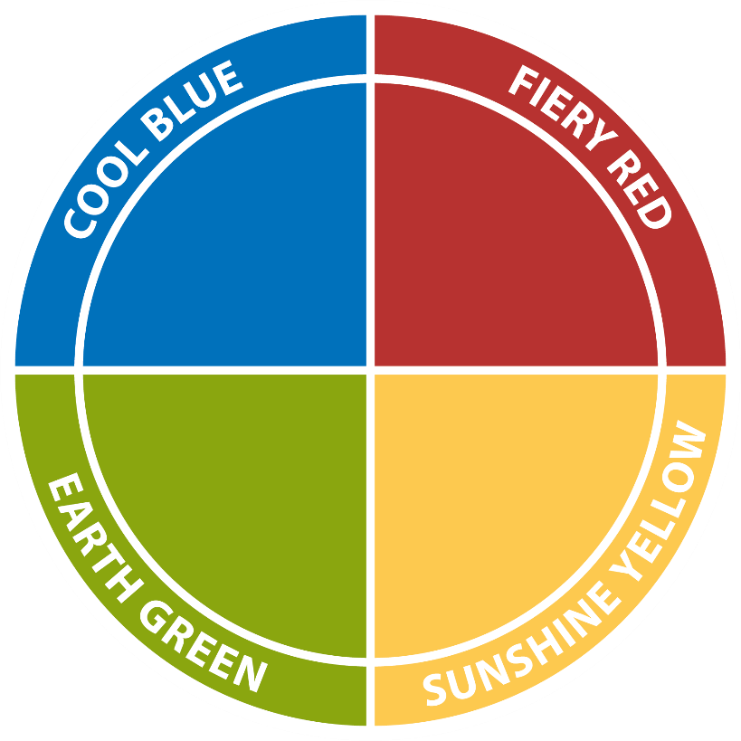
Your colour energy mix
Competitive
Demanding
Determined
Strong-willed
Purposeful
Notes:
Say: Lets explore each of the four colour energies in more detail. The goal is for you to identify how and when you use each of the four colour energies AND which colour energy or energies you believe you use more than the others.
Describe Fiery Red energy, using the words on the screen and your own definition. If you wish, you can use the Insights card game, and choose ahead of time four statements for each colour energy that are a good representation of that colour energy. Read those statements as part of the introduction for each colour energy to help broaden participants’ definitions of the colour energy.)

Slide 22
When we are using our
Fiery Red energy, we...
Are active and move in a positive and firm direction
Have a strong determination
that influences those we
interact with
Are single-minded and determined
in our focus
on results
Approach others in a direct and straightforward manner
Seek an outcome that is specific and tangible
Notes:
Share that these are some additional ways that Fiery Red energy may show up.
Say: Please type into the chat box an example of how YOU use Fiery Red energy. Which aspects of this colour energy do you connect with, and what situations do you find yourself drawing on your Fiery Red energy?

Slide 23
Your colour energy mix
Caring
Encouraging
Sharing
Patient
Relaxed
Notes:
Describe Earth Green energy, using the words on the screen and your own definition. Point out that Earth Green is opposite on the wheel to Fiery Red, and their opposite nature can be heard and seen in the words and statements used to describe each energy.
(Facilitator to have Insights card game with them, and have chosen ahead of time four statements for each colour energy that are a good representation of that colour energy. Read those statements as part of the introduction for each colour energy to help broaden participants’ definitions of the colour energy.)

Slide 24
When we are using our
Earth Green energy, we …
View the world through what we value and what is important to us
Seek harmony and depth in relationships
Defend what we value with quiet determination
and persistence
Ensure all individual perspectives are heard and considered in making choices or decisions
Prefer democratic approaches that respect the individual
Notes:
Share that these are some additional ways that Earth Green energy may show up.
Say: Please type into the chat box an example of how YOU use Earth Green energy. Which aspects of this colour energy do you connect with, and what situations do you find yourself drawing on your Earth Green energy?

Slide 25
Your colour energy mix
Sociable
Dynamic
Demonstrative
Enthusiastic
Persuasive
Notes:
Describe Sunshine Yellow energy, using the words on the screen and your own definition.
(Facilitator to have Insights card game with them, and have chosen ahead of time four statements for each colour energy that are a good representation of that colour energy. Read those statements as part of the introduction for each colour energy to help broaden participants’ definitions of the colour energy.)

Slide 26
When we are using our Sunshine Yellow energy, we...
Radiate enthusiasm and encourage participation
Enjoy and seek the company
of others
Approach others in a persuasive, engaging and inviting manner
Have a desire
to be involved
Like to be noticed and appreciated for their contributions
Notes:
Share that these are some additional ways that Sunshine Yellow energy may show up.
Say: Please type into the chat box an example of how YOU use Sunshine Yellow energy. Which aspects of this colour energy do you connect with, and what situations do you find yourself drawing on your Sunshine Yellow energy?

Slide 27
Your colour energy mix
Cautious
Precise
Deliberate
Questioning
Formal
Notes:
Describe Cool Blue energy, using the words on the screen and your own definition. Point out that Cool Blue is opposite on the wheel to Sunshine Yellow, and their opposite nature can be heard and seen in the words and statements used to describe each energy.
(Facilitator to have Insights card game with them, and have chosen ahead of time four statements for each colour energy that are a good representation of that colour energy. Read those statements as part of the introduction for each colour energy to help broaden participants’ definitions of the colour energy.)

Slide 28
When we are using our
Cool Blue energy, we …
Desire to know and understand the world around us
Maintain a detached and objective standpoint
Value independence and intellect
Think things through before committing to action
Like information to be accurate and complete before proceeding
Notes:
Share that these are some additional ways that Cool Blue energy may show up.
Say: Please type into the chat box an example of how YOU use Cool Blue energy. Which aspects of this colour energy do you connect with, and what situations do you find yourself drawing on your Cool Blue energy?
Say: You now have an example of how you use all four colour energies. You may also have a sense of which colour energies you use most and least. What about the person you would like to connect more with? Any ideas of which might be their preference?

Slide 29
Insights Discovery Colour Energies
Cautious
Precise
Deliberate
Questioning
Formal
Competitive
Demanding
Determined
Strong-willed
Purposeful
Caring
Encouraging
Sharing
Patient
Relaxed
Sociable
Dynamic
Demonstrative
Enthusiastic
Persuasive
Notes:
Explain that all four colour energies are equally positive and bring strengths to an individual and a team. And, all four colour energy strengths can be overextended and turn into weaknesses. Insights calls these the Good Day and Bad Day characteristics of the colour energies.
PRODUCER: 4 Box (or one at a time in the main Chat)
Say: You saw in the eLearning module that while each colour energy is equally good and useful, those strengths can also all be overextended and become weaknesses.
Say: Use the four boxes on the screen to type in what you think each colour energy would look like on a “bad day”.
After participants have given some answers, click to review the words on the slide.

Slide 30
Insights Discovery Colour Energies
Cold
Stuffy
Indecisive
Suspicious
Reserved
Driving
Aggressive
Controlling
Intolerant
Overbearing
Stubborn
Plodding
Docile
Bland
Reliant
Flamboyant
Excitable
Indiscreet
Frantic
Hasty
Notes:
Explain that all four colour energies are equally positive and bring strengths to an individual and a team. And, all four colour energy strengths can be overextended and turn into weaknesses. Insights calls these the Good Day and Bad Day characteristics of the colour energies.
PRODUCER: 4 Box (or one at a time in the main Chat)
Say: You saw in the eLearning module that while each colour energy is equally good and useful, those strengths can also all be overextended and become weaknesses.
Say: Use the four boxes on the screen to type in what you think each colour energy would look like on a “bad day”.
After participants have given some answers, click to review the words on the slide.

Slide 31
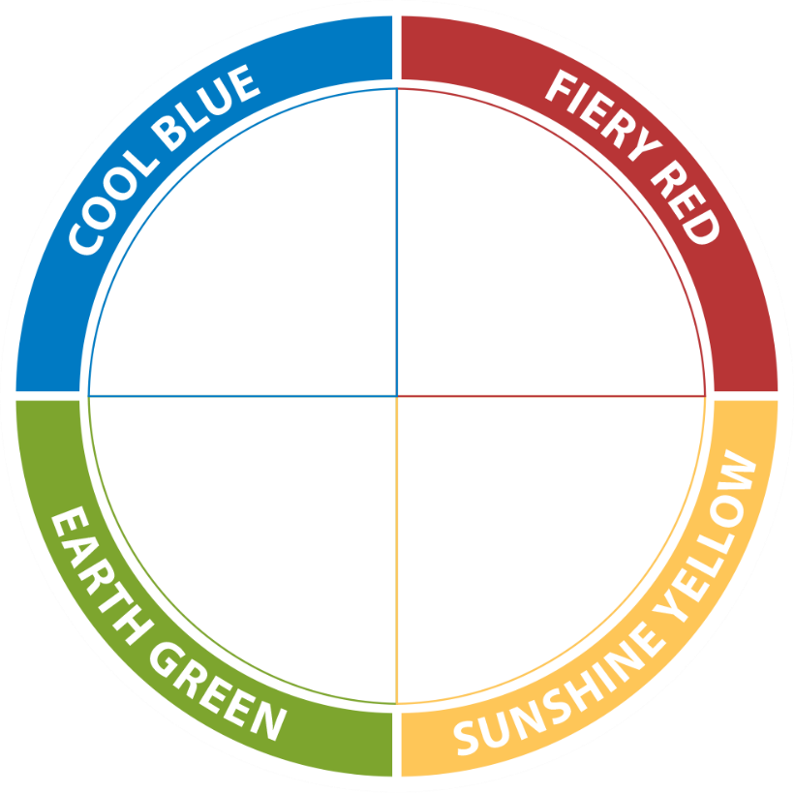
Your colour energy mix
We each have all
four colour energies within us; it is the combination of the
four energies that creates the unique YOU.
Notes:
Say: Based on what we have discussed so far, type into the chat box what order of the colour energies you think you prefer. Is this similar or different to the order you had for the statement exercise earlier?
CHAT
Say: Next we will discuss a little bit of the psychology behind the model to help you understand where the colour energies came from, and also to help you learn how to recognise these in other people.

Slide 32
The Jungian Preferences

Slide 33
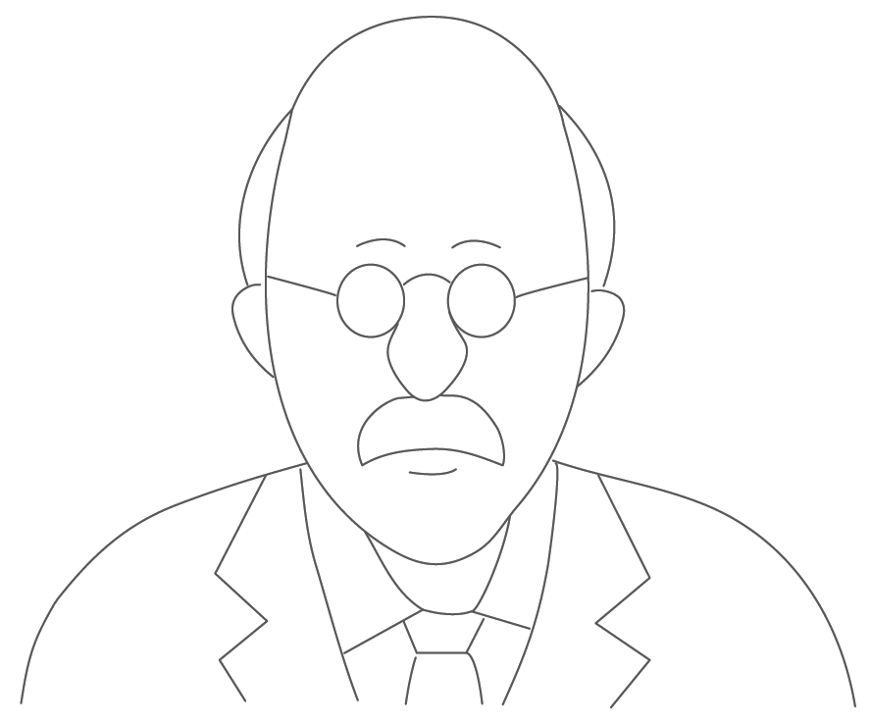
The Jungian preferences
“Every advance,
every conceptual achievement of mankind has been connected with an advance in self awareness.”
– Dr Carl G Jung
Notes:
Say: As you saw in the eLearning module, Dr. Carl Jung was a Swiss doctor and one of the 20th century’s greatest psychologist. He was interested in our nature, described in three sets of psychological preferences
How we are oriented to our environment
How we make decisions
How we interpret information.
Say: You may have noticed that we talk about “preferences” a lot. Lets explore what we mean by preferences.
Ask the participants to fold their arms in their normal way and notice how it feels.
Then ask them to cross their arms in the opposite way. For most people this feels a bit awkward and uncomfortable. Share with them, that if left in that position for a while, at some point we are all likely to flip our arms back to our normal or most comfortable preference.
Link this to the idea of psychological preferences – we have a habitual way of responding; if asked to do things differently we are able to with conscious effort but it does not always feel comfortable. In time, without continuous conscious effort, we often go back to our usual preference.

Slide 34
Your ‘attitude’
Introversion
Quiet
Observant
Inwardly focused
Depth focused
Intimate
Reserved
Reflective
Thoughtful
Cautious
Extraversion
Talkative
Involved
Outwardly focused
Breadth focused
Gregarious
Outgoing
Action oriented
Outspoken
Bold
Notes:
POLL OR DRAW
PRODUCER: Add Poll showing range of preference OR use the Draw tool to allow participants to make a mark representing where they place themselves on each continuum.
Say: This set of preferences explores how we are oriented to the environment (to the object), or, how we react to experiences. The eLearning module introduced you to the concepts of introversion and extraversion.
Introversion – Internally, through observation and reflection
Extraversion – Externally through engagement, involvement and taking action
Say (DRAW option): It is important to emphasise that our use of the preferences is on a continuum rather than being an either/or choice. Take a look at the sets of preferences on the screen, and make a mark along the line that represents where you would place yourself for each pair of words. As you do this, notice whether your marks for each pair of words are more on one side or the other; or you may end up being right in the middle. This gives you a sense of whether you may prefer introversion of extraversion; or perhaps are fairly equal in this set of preferences.
Say (POLL option): It is important to emphasise that our use of the preferences is on a continuum rather than being an either/or choice. As you look at the pairs of words, imagine making a mark along each continuum indicating which is most like you. As you look at all the sets of words, would you make more marks on the introverted side or on the extraverted side, or would it be fairly equal? Share this preference by making a selection in the Poll.
When working with a Team:
Say: Are there any surprises about this distribution on our team? What are some examples of how Extraversion shows up on our team? Introversion?

Slide 35
Your decision making ‘functions’
Thinking
Formal
Impersonal
Analytical
Detached
Objective
Strong-minded
Competitive
Logical
Task focused
Feeling
Informal
Personal
Instinctive
Involved
Subjective
Flexible
Accommodating
Values-based
Relationship focused
Notes:
POLL OR DRAW
PRODUCER: Add Poll showing range of preference OR use the Draw tool to allow participants to make a mark representing where they place themselves on each continuum.
Say:
As you saw in the eLearning module, the next set of preferences explores how we make Decisions
Thinking – With our ‘head’ using analysis and a logical rationale
Feeling – With our ‘heart’ deciding on what something is worth, using our personal values
Say: Just as with Introversion and Extraversion, our use of these preferences is on a continuum rather than being an either/or choice.
Say (DRAW option): Take a look at the sets of preferences on the screen, and make a mark along the line that represents where you would place yourself for each pair of words. As you do this, notice whether your marks for each pair of words are more on one side or the other; or you may end up being right in the middle. This gives you a sense of whether you may prefer thinking or feeling; or perhaps are fairly equal in this set of preferences.
Say (POLL option): As you look at the pairs of words, imagine making a mark along each continuum indicating which is most like you. As you look at all the sets of words, would you make more marks on the thinking side or on the feeling side, or would it be fairly equal? Share this preference by making a selection in the Poll.
When working with a Team:
Say: Are there any surprises about this distribution of decision-making preferences? What are some examples of when we use the Thinking function as a team? Feeling function?

Slide 36
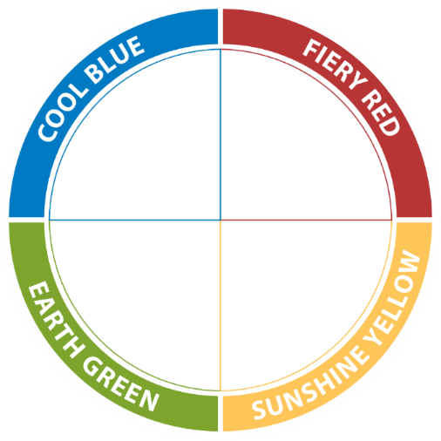
Jungian Preferences and the Colour Energies
Thinking
Introversion
Extraversion
Feeling
Notes:
Click through the next four slides to highlight how the combination of Introversion or Extraversion with Thinking or Feeling creates the four colour energy quadrants.

Slide 37

Jungian Preferences and the Colour Energies
Introversion

Slide 38

Jungian Preferences and the Colour Energies
Extraversion

Slide 39

Jungian Preferences and the Colour Energies
Thinking

Slide 40

Jungian Preferences and the Colour Energies
Feeling

Slide 41
Jungian Preferences and the Colour Energies
Cool Blue
The combination of the Introverted
and Thinking preferences:
Task-focused
Calm under pressure
Thoughtful
Objective
Fiery Red
The combination of the Extraverted
and Thinking preferences:
Enjoying high activity
Working with others
Being logical
Focusing on the facts
Earth Green
The combination of the Introverted
and Feeling preferences:
Depth in relationships
Reflection
Harmony
Consensus
Sunshine Yellow
The combination of the Extraverted
and Feeling preferences:
Sociability
Consideration for others
Being action-orientated
Entertaining

Slide 42
Your perceiving ‘functions’
Sensation
Specific
Present-oriented
Realistic
Consistent
Down-to-earth
Practical
Precise
Factual
Step-by-step
Intuition
Global
Future-oriented
Imaginative
Unpredictable
Blue-sky
Conceptual
General
Abstract
Spontaneous
Notes:
Say: The eLearning module introduced a third set of preferences, the perceiving functions of Sensation and Intuition. Those with a preference for Sensation may identify with the words on the left, while those with a preference for Intuition may identify more with the words on the right.
Say: As practice, lets come up with what might be present for someone with each of these preferences when observing an image.

Slide 43
When you see the
next slide, write down what is there for you.
Notes:
ONLY USE SLIDE IF NOT USING ELEARNING MODULE – If your participants completed the eLearning module, they have already done this exercise.
Say: We are about to look at a third set of preferences, the perceiving functions, Sensation and Intuition
(Stick with these words as you go to the next slide – so you don’t ‘lead’ the participants’ descriptions.)

Slide 44
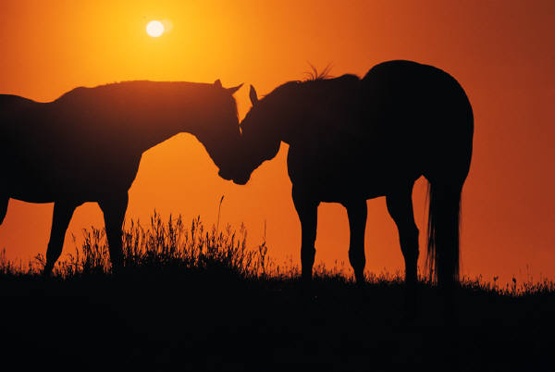
© The Insights Group Ltd, 2009-2020. All rights reserved.
Notes:
If your participants completed the eLearning module and you are using this exercise as a review:
Say: Type into the chat box what a person with a preference for Sensation might perceive.
Watch for descriptive words, using five senses.
Say: Now type into the chat box what a person with a preference for Intuition might perceive.
Watch for intuitive words that emerge from the image, but do not describe the image.
If your participants did not complete the eLearning module, and you want them to do this exercise:
Say: Type into the chat box what is there for you.
(Give participants 2 minutes, or notice when typing slows down)

Slide 45
What was there for you?
Sensation (S)
Horse
Sun
Grass
Orange
Intuition (N)​
Friendship
Open space​
Freedom
​Companionship
Notes:
When working with participants who completed the eLearning module:
Say: Here are some examples of typical Sensation and Intuition responses (we use N for Intuition because I represents Introversion).
When working with participants who have not completed the eLearning module:
Say: You may have noticed that people’s responses tend to fall into one of two categories. Some of you described what was in the picture, what was actually there in front of you. Others of you described what the picture made you think about or what it reminded you of, or just what came to mind when you looked at it. The first way of taking in and processing information represents more of a Sensation preferences, using your five senses to process what you see, hear, smell, taste, or touch. The second way of taking in and processing information uses the 6th sense of Intuition to often “see” more than meets the eye.
Say: Here are some examples of typical Sensation and Intuition responses (we use N for Intuition because I represents Introversion).
Look back at your answer; did you use more Sensation or Intuition.
Type into the chat which you used more. If you had some of both in your answer, which was your first response more closely associated with?

Slide 46
Your perceiving ‘functions’
Sensation
Specific
Present-oriented
Realistic
Consistent
Down-to-earth
Practical
Precise
Factual
Step-by-step
Intuition
Global
Future-oriented
Imaginative
Unpredictable
Blue-sky
Conceptual
General
Abstract
Spontaneous
Notes:
Say: Which do you think is your preference, Sensation or Intuition, or both?
PRODUCER: Add Poll showing range of preference.
Say: What are some examples of how these preferences show up on our team? How do we use our Sensation? How do we use our Intuition? Are they equally valued?

Slide 47
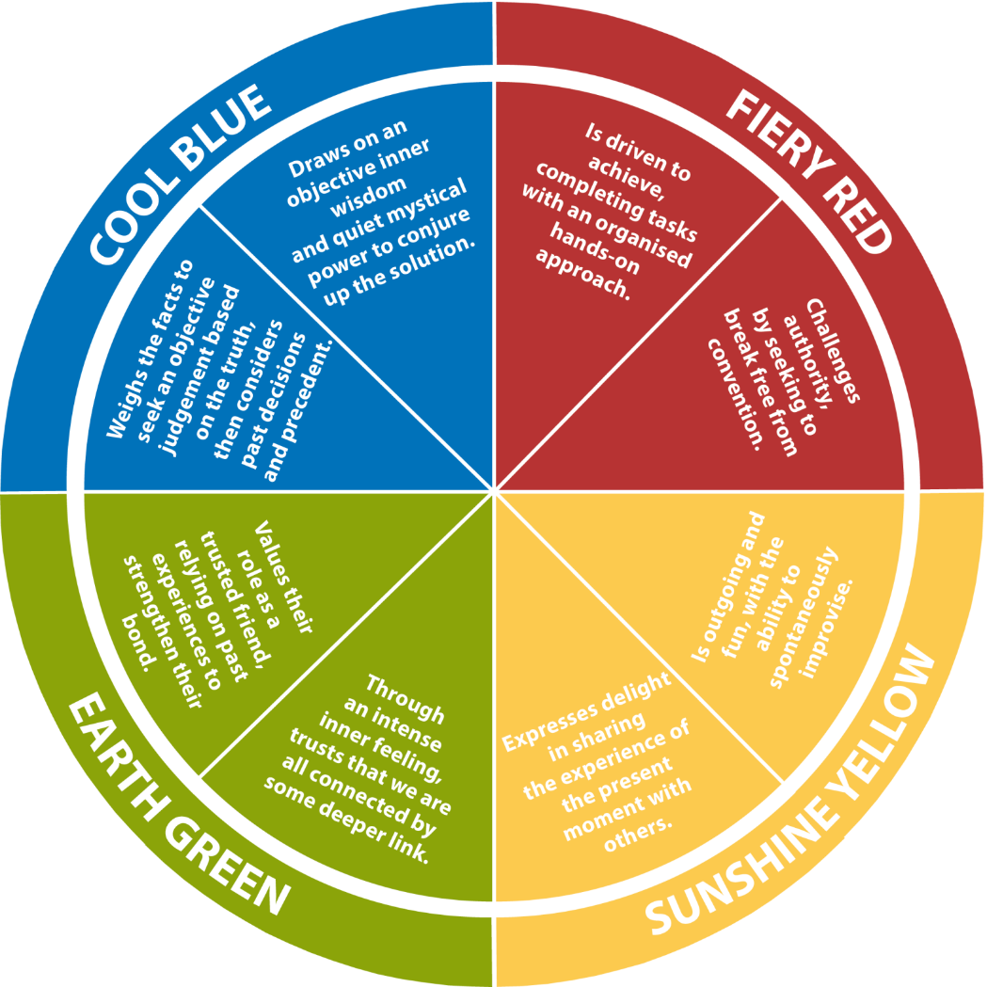
A combination of Fiery Red with Sensation
A combination of Cool Blue with Intuition
A combination of Earth Green with Sensation
A combination of Sunshine Yellow with Intuition
A combination of Cool Blue with Sensation
A combination of Fiery Red with Intuition
Sensation and Intuition
in every colour energy
A combination of Sunshine Yellow with Sensation
A combination of Earth Green with Intuition
Notes:
OPTIONAL SLIDE: Using the slides with the two different statements for each colour energy, read out the statements and ask the participants to identify, for each colour energy, which
statement is more sensation and which is more intuition. Remind the participants that sensation and intuition are present in every quadrant and reveal different flavours of each colour energy.

Slide 48
Summary of Jung’s Psychological Preferences
How we are oriented to the environment (to the object)
Introversion – Internally, through observation and reflection
Extraversion – Externally through engagement, involvement and taking action
How we make decisions
Thinking – With our ‘head’ using analysis and a logical rationale
Feeling – With our ‘heart’ deciding on what something is worth, using our personal values
How we take in and process information
Sensation – In a concrete, realistic and tangible way, grounded in the present
Intuition – Finding meaning through interpretation, and future possibilities

Slide 49

Face validity
Notes:
Option 1 (2.5 hour session): This is the time to email profiles to the participants. Let them know that you would like them to read the Overview section of their profile and complete a short assessment of the face validity of the profile, which is described on the next slide. They will have 20-30 minutes to do this and take a short stretch break, and then return for the second portion of the session. Before the break, move to the next slide.
Option 2 (2 hour session): If profiles were sent out prior to the session, you may have asked participants to come to the session with their face validity already calculated, and having identified some key statements they would like to share from their profile. If so, you can ask participants to answer the Poll representing their face validity, and move on.

Slide 50
Review the Overview (pages 6-8)
Put stars ** next to any statements you believe are particularly accurate
Put a ? beside those statements you believe do not describe you. Rather than stick on a specific word, consider the whole or half sentence
Remember to seek feedback from someone you trust on any statements in your Profile which you are not certain describe you
Count the sentences that did not describe you ? and multiply by 2. Subtract that number from 100.
1.5 sentences x 2 = 3
100% - 3% = 97% Accuracy
Notes:
PRODUCER: Set up Poll (four options)
90% - 100%
80-89%
70-79%
< 70%
Option 1: If participants are taking a break and reading their profiles now, leave this slide up. PRODUCER opens the poll and you can see people’s responses as they return from break. This will let you know when everyone is back.
Option 2: If they have done this ahead of time, ask them to answer the poll with the % they calculated so that you can check this before moving on.

Slide 51
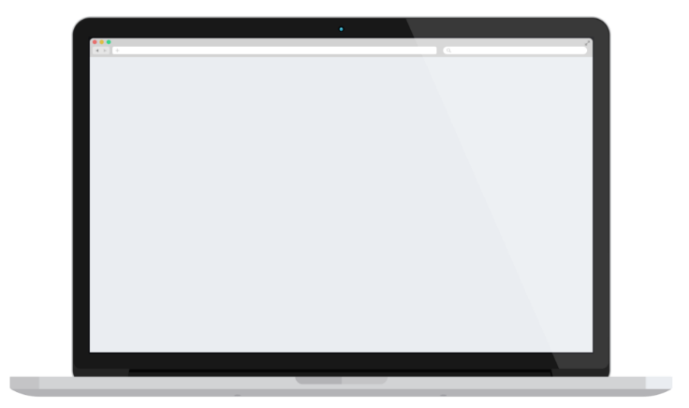
Evaluator Frames
Frame 2
Frame 1
Amicable and quick L 1 2 3 4 5 M
Reliable and restrained L 1 2 3 4 5 M
Forceful and goal-oriented L 1 2 3 4 5 M
Methodical and logical L 1 2 3 4 5 M
Frame 2
Calm and even-tempered L 1 2 3 4 5 M
Determined and dominant L 1 2 3 4 5 M
Buoyant and light-hearted L 1 2 3 4 5 M
Exact and precise L 1 2 3 4 5 M
Notes:
Refresh the steps in the evaluator and how it now reveals within the pages of their profile.
Explain briefly:
There are 25 frames, each with 4 word pairs.
For each word pair in the evaluator, you indicated a MOST like me, a LEAST like me and then scored the remaining 2 pairs.
Most like me scores a 6, least like me scores zero.
The total overall score for each colour energy is averaged (divided by 25) to create the Conscious Graph

Slide 52
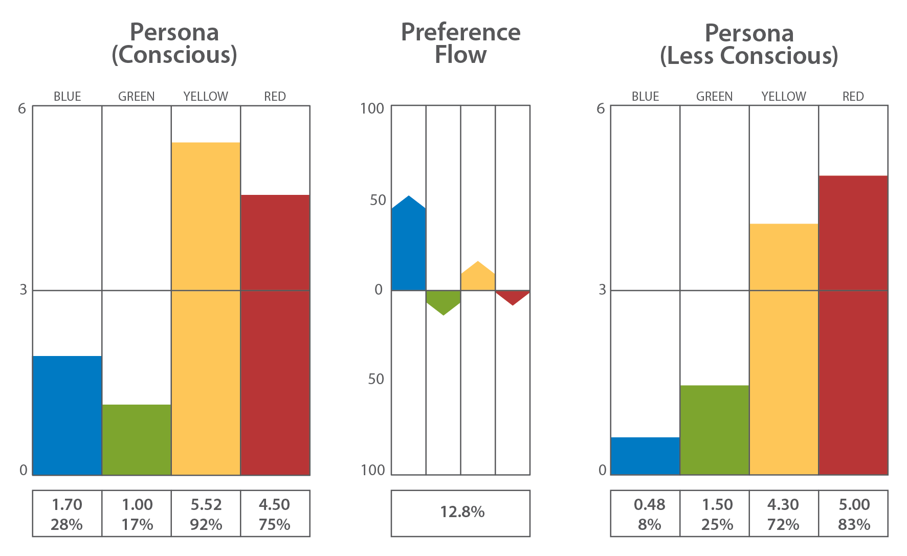
Colour Energy graphs – dynamics
The direct responses to the evaluator.
Your intentional self. Combines;
- who you are
- who you want to be and
- who you believe you’re expected to be.
How you “ACT”.
The indirect responses to the evaluator.
Less aware of these energies. Suggests your more instinctive behavior.
Highlights possible blind spots.
How you might “REACT”.
The portrait picture of you
Preference Flow: Highlights which colour energies you might be putting a conscious effort into adjusting, to meet the needs of your environment
The candid photograph
Notes:
Say: Turn to the back of your profile where you will see several graphs.
Introduce the graphs as you would in a face to face session.
ASK: Type in the chat box the order of your color energies based on your Conscious Persona graph. Use a / to indicate how many colour energies are above the midline (facilitator to give an example) Were you surprised, or was this pretty much what you were expecting?

Slide 53
Break out room activity: Profile sharing
You will be placed in small groups in breakout rooms
for 10 minutes.
Each person is requested to share, as you are comfortable:
Which statements from your profile Overview section do you believe are most pertinent or relevant for you and why?
What is an example of one strength and one potential weakness from your profile showing up in your work?
Notes:
BREAKOUT ROOMS
(Facilitators may choose the questions to ask groups to discuss in breakout rooms. It may be sharing a strength or value to the team statement, or maybe focus on communicate strategies and barriers. It also could be to invite participants to share from their graphs, perhaps what their preference flow story might be. Select an area that fits with the objectives of the session)
PRODUCER: Set up and manage breakout rooms. Ideally three people in each.

Slide 54
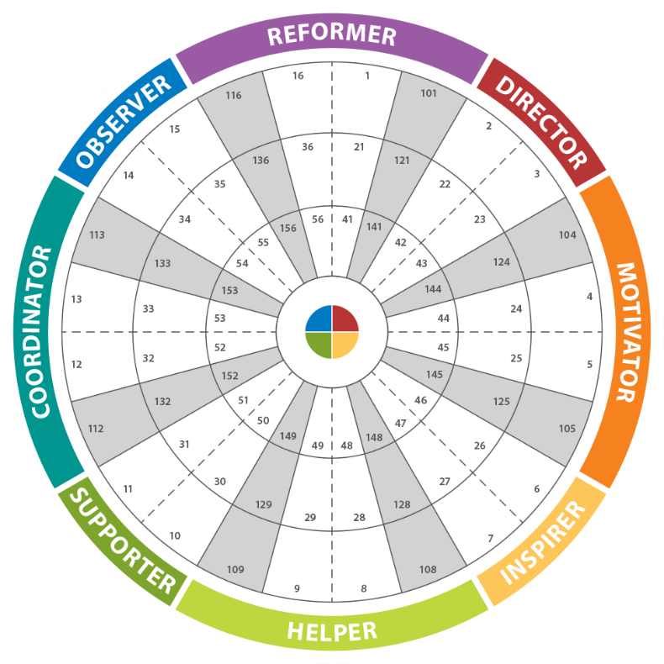
The Insights Discovery 72-Type wheel
Wheel position determined by:
Order of colour energies
Number of colour energies above the midline
Notes:
Ask participants to turn to the wheel page in their profile. Share that only two factors determine an individual’s wheel position for either their conscious or less conscious graphs – the order of the colours and how many are above the midline. Make the connection that the bright coloured pie chart represents the Conscious persona graph, and the light coloured pie chart represents the Less Conscious persona graph.
Someone may say “I only have one pie chart”. You then have the opportunity to explain that for some people the order of colours and the number above the line do not change between the conscious and less conscious graphs, so these two pie charts are on top of each other.
Use the following slides to help explain how the wheel position is connected to the bar charts.

Slide 55
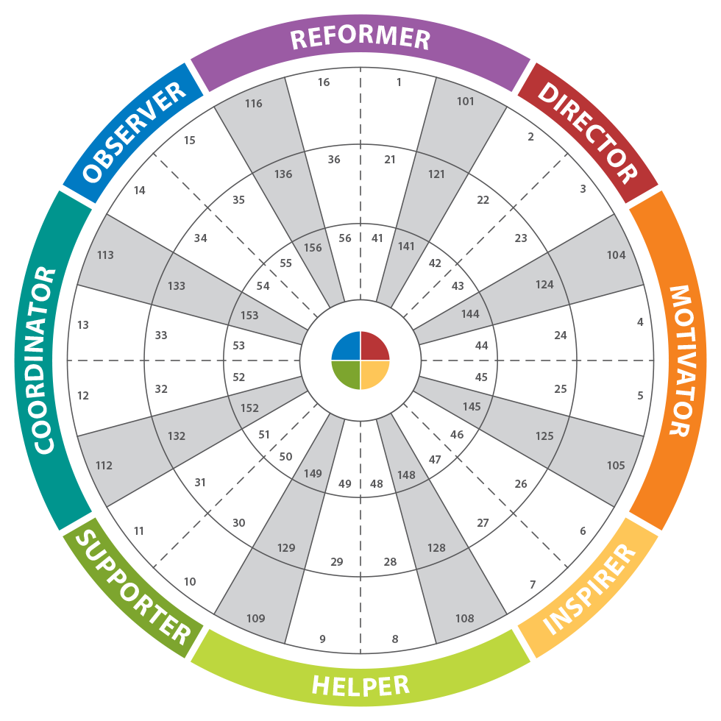
Focused Type
Focused ring =
3% of population
Notes:
Review that Focused Ring has 1 colour above the midline and is 3% of the Population

Slide 56
Classic Type
Classic Ring =
54% of population
Notes:
Review that Classic Ring has 2 colours above the midline and is 54% of the Population

Slide 57
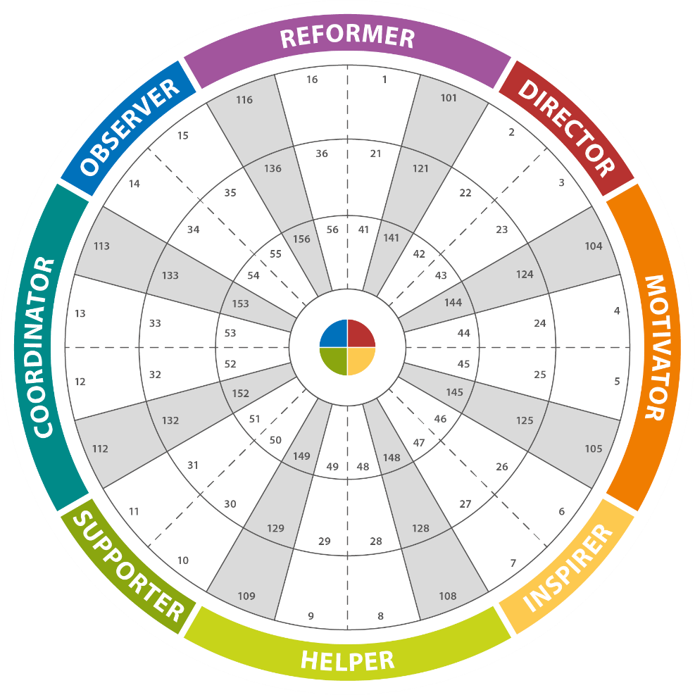
Accommodating
Type
Accommodating Ring = 43%
of population
Notes:
Review that Accommodating Ring has 3 colours above the midline and is 43% of the Population

Slide 58
Creative types pull on two opposing energies
Creative positions = 9% of population
Notes:
Review that Creative Types have their first 2 colour energies as opposites and is 9% of the Population

Slide 59
Plot your own position on the wheel
Notes:
DRAW/TEXT FUNCTION – Producer to enable drawing for all participants (Select ‘Pod Options’ drop down then ‘Enable Participants to draw’) Select Draw
Ask the participants to put their initials in their wheel position using the draw/text function.
Producer to disable drawing for all participants (Select ‘Pod Options’ drop down then untick ‘Enable Participants to draw’ and select Draw button to disable drawing)
Say: You have created your own team wheel! What observations do we have about this “team”? Any surprises about individuals you know? What might our strengths be? What might be some areas of stretch for us? Any action ideas (if this is a real team)?

Slide 60
Insert Team Wheel
Notes:
OPTIONAL: If working with an intact team, insert team wheel here

Slide 61

Working with your Insights Discovery Personal Profile
Notes:
If you have an extended amount of time, select additional pages from the profile and exercises that are most relevant to the group. E.g. Key Strengths and Possible Weaknesses, Effective Communication

Slide 62
Recognising Types

Slide 63
Recognising types
Every time you meet someone you have the opportunity to practise your skill of recognising and adapting to their colour energies.
Notes:
Open a discussion on how you can recognise the colour energies in action encouraging ideas from the group about what they would look out for.
PRODUCER: 4 box exercise or in Chat
Ask participants to write down clues related to body language, verbal style, interactions that would give them a clue that somebody was using the Good Day form of each colour energy.

Slide 64
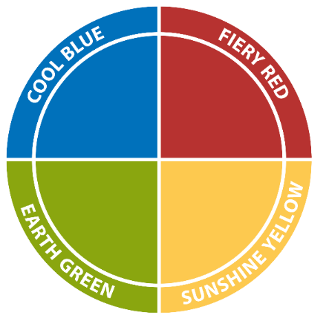
Recognising types
Step One:
Formal
Do they “speak to think”
(Fiery Red/Sunshine Yellow) or
“think to speak”
(Cool Blue/Earth Green)?
Quiet
(think to speak)
Talkative
(speak to think)
Step Two:
Are they more formal/task focused
(Cool Blue/Fiery Red) or more
informal/relationship focused
(Earth Green/Sunshine Yellow)?
Informal
Notes:
Talk through this shortcut approach to identifying what colour energy a person may be using at any point in time.
Remind participants about the person they identified at the beginning that they would like to have a stronger connection with. Which colour energies do they think this person uses most often?

Slide 65
Watch My Back feedback exercise
Cautious
Precise
Deliberate
Questioning
Formal
Competitive
Demanding
Determined
Strong-willed
Purposeful
Caring
Encouraging
Sharing
Patient
Relaxed
Sociable
Dynamic
Demonstrative
Enthusiastic
Persuasive
Notes:
Optional exercise: (variation of Watch My Back feedback exercise)
If working with a team of less than 10 and time allows, this is a chance for the team to provide feedback about which colour energies they experience most often in each other. Working with one team member at a time, the facilitator asks the team to type their initials on the screen next to the colour energy quadrant or quadrants that they experience most often from that individual. It is most useful if the facilitator asks for several individuals to provide examples to support the colour energy or energies they selected in the other person.
PRODUCER – Turns on DRAW tool, and clears screens after each individual. Facilitator may suggest that individuals could take a screenshot of the feedback before it is cleared for the next individual.

Slide 66
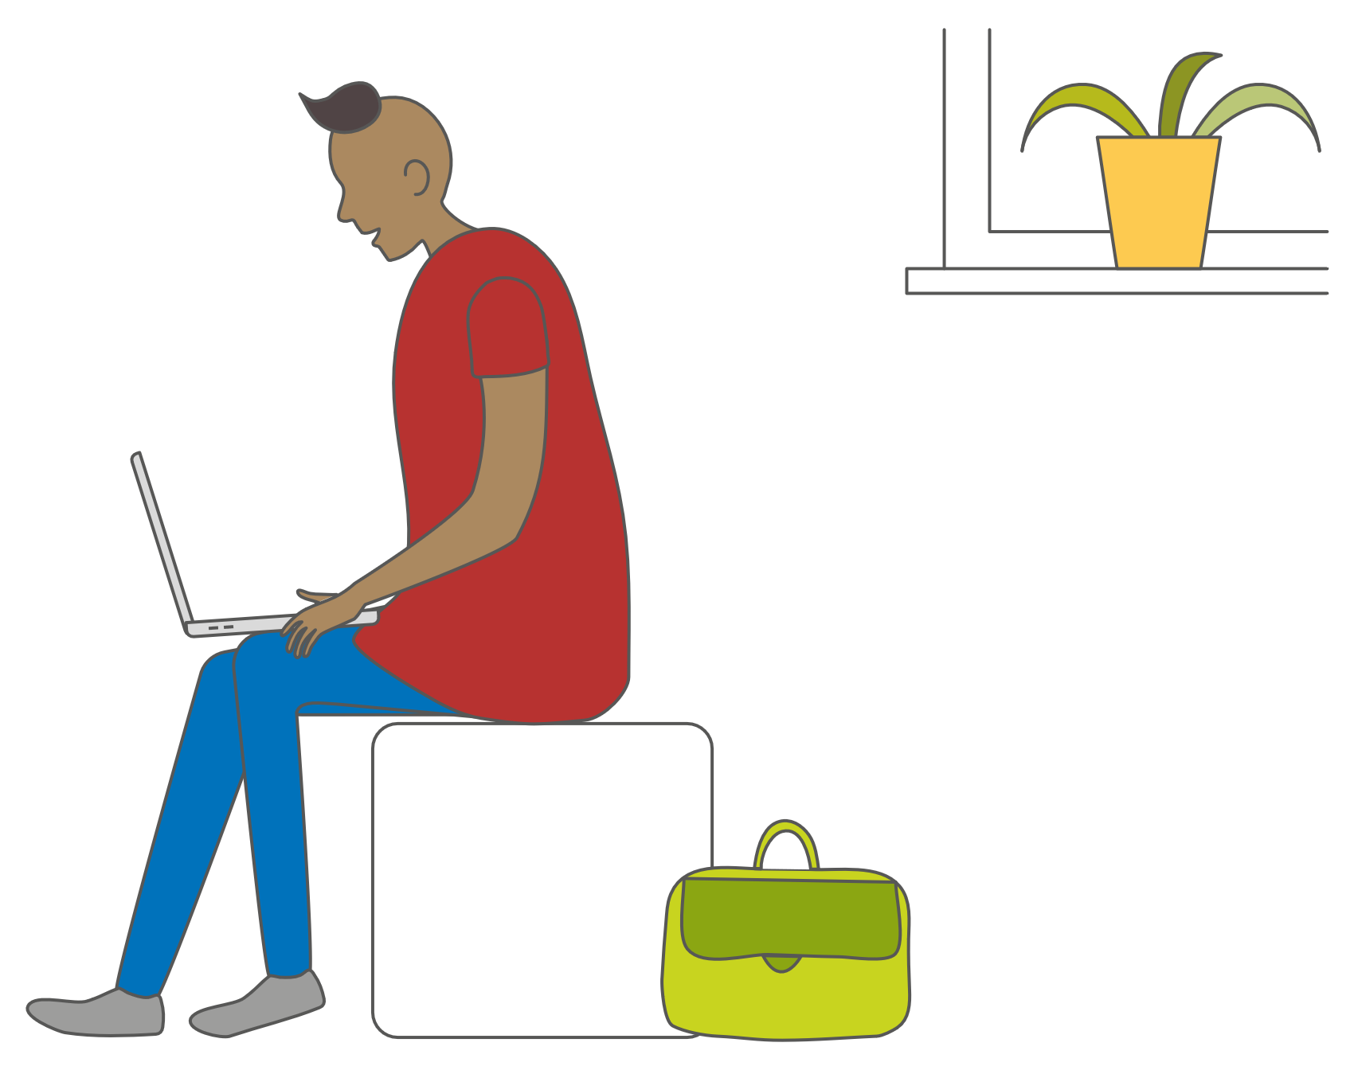
Be the detective …
Email communications
What clues might indicate
the sender’s style?
Notes:
Now that you have a taste for the color energy preferences…let’s see how this might look in email…
Your job is to guess which color energy preference this email reflects and why!

Slide 67
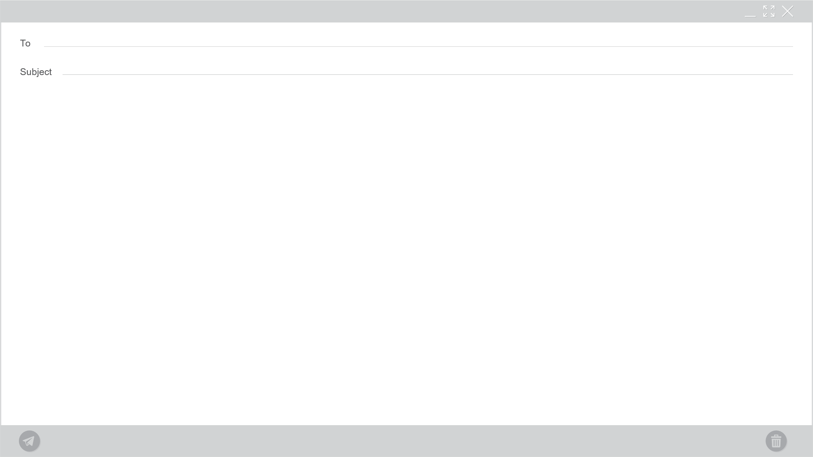
TRIP!!!
GANG!
We did it! I was picked to represent our team for the Japan Manufacturing Excellence Exchange Programme. Wish you could all go with me; we’d have a great time!
I’ll be leaving at the end of March and will be gone for two weeks.
Wish me luck!
Preference for Sunshine Yellow energy
P.S. If you want me to ask them anything while I am there, send me the stuff before I go.
Notes:
POLL – Asking participants to guess which color energy preference this email reflects
Review slide

Slide 68
Japan Manufacturing Excellence Exchange Programme Trip
The undersigned will be departing from MSP International Airport at 0830, Monday, March 26, for Tokyo, Japan to participate in the Manufacturing Excellence Exchange Programme.
I will be visiting Toyota, Mitsubishi, Nissan, and Panasonic over an 11-day period.
Please familiarise yourselves with these companies and forward your detailed questions about their processes and operation to me by March 10 so I can compile and organise them prior to my trip.
A debrief will be held on April 12 at 1400 to review all aspects and learning from the trip.
While I am gone Dave Smith will be in charge of the group.
Sincerely,
Preference for Cool Blue energy
Notes:
POLL – Asking participants to guess which color energy preference this email reflects
Review slide

Slide 69
Your Upcoming Visit
Dear Janice,
I am so pleased you are coming to visit. It will be a great chance for us to get to know each other better and for me to really understand what I can do to help you in your business. I’ve booked you into a great little inn by the water. They give wonderful personal service and the view of the water and mountains is spectacular.
I’m certain we will get a lot accomplished and strengthen our partnership immensely.
Looking forward to seeing you,
Preference for Earth Green energy
Notes:
POLL – Asking participants to guess which color energy preference this email reflects
Review slide

Slide 70
SEND ME YOUR PHONE # ASAP I NEED TO TALK TO YOU!
Sent: Tuesday, February 4, 2020 13:15
Notes:
Part 1
Click forward for Part 2

Slide 71
FORGET IT FIGURED IT OUT MYSELF!
Preference for Fiery Red energy
Sent: Tuesday, February 4, 2020 13:17
Notes:
POLL – Asking participants to guess which color energy preference this email reflects
Note… didn’t even have to open the e-mail…

Slide 72






Recognising
Type
Find People, jobs and…
Write a post
Sukhi – 1st
Business Development Manager
Jaz – 1st
Associate Consultant
Hi
Fab question so great to hear from
you! I’m loving it, virtual coffees, remote hangouts, catching up with peeps I haven’t had time to recently ☺ All good thanks, apart from the words ‘social distancing’ (double shudder!)
it’s all great! Glad that all the stores
no longer have shortages. What a NIGHTMARE! I was panicking about running out of the essentials – Lol!!! Don’t be a stranger - CGJ
72
16 Comments
Like
Comment
Share
Notes:
The following slides can be used as an alternative to the email scenarios for recognising

Slide 73
Hi
Fab question so great to hear from you! I’m loving it, virtual coffees, remote hangouts, catching up with peeps I haven’t had time to recently ☺ All good thanks, apart from the words ‘social distancing’ (double shudder!) it’s all great! Glad that all the stores no longer have shortages. What a NIGHTMARE! I was panicking about running out of the essentials – Lol!!! Don’t be a stranger - CGJ

Slide 74
Recognising
Type
Find People, jobs and…
Write a post
Sukhi – 1st
Business Development Manager
Mags – 1st
Executive Coach
BAU really, working through my to do list. Some things are taking longer but my husband is doing the shopping so at least I don’t have to fit that in.
Let’s schedule something for a few weeks time
Stay safe
72
16 Comments
Like
Comment
Share
Notes:
The following slides can be used as an alternative to the email scenarios for recognising

Slide 75
BAU really, working through my to do list. Some things are taking longer but my husband is doing the shopping so at least I don’t have to fit that in.
Let’s schedule something for a few weeks time
Stay safe

Slide 76
Recognising
Type
Find People, jobs and…
Write a post
Sukhi – 1st
Business Development Manager
Jeff – 1st
Team leader
I am enjoying the quiet time and space to think. Having completed a number of tasks that were building up.
I am researching the best method to run a virtual session. Zoom seems robust but I do worry about the security holes it has.
I need to research the cost of using all platforms.
72
16 Comments
Like
Comment
Share
Notes:
The following slides can be used as an alternative to the email scenarios for recognising

Slide 77
I am enjoying the quiet time and space to think. Having completed a number of tasks that were building up.
I am researching the best method to run a virtual session. Zoom seems robust but I do worry about the security holes it has.
I need to research the cost of using all platforms.

Slide 78
Recognising
Type
Find People, jobs and…
Write a post
Sukhi – 1st
Business Development Manager
Lisa – 1st
Care Assistant
Hey, all is good with us thanks for asking. Nice to be able to spend some time together but missing the extended family. How are you doing? I hope all is well with you and the family and that you are staying safe. Please let me know if you need anything and I hope you know I’m always here if you need a chat, Facetime, Skype, or a phone whatever works best for you.
Take care speak soon.
72
16 Comments
Like
Comment
Share
Notes:
The following slides can be used as an alternative to the email scenarios for recognising

Slide 79
Hey, all is good with us thanks for asking. Nice to be able to spend some time together but missing the extended family. How are you doing? I hope all is well with you and the family and that you are staying safe. Please let me know if you need anything and I hope you know I’m always here if you need a chat, Facetime, Skype, or a phone whatever works best for you.
Take care speak soon.

Slide 80

Adapting and connecting
Notes:
This is about being authentic and reaching out towards another person by recognising their preferences and adapting to them
5% is all it takes to make a difference
The desire to connect is the most important component.
It takes practice.

Slide 81

Adapting and connecting
Cool Blue
Be well prepared
and thorough
Do not be flippant on
important issues
Fiery Red
Be direct and to the point
Do not hesitate or waffle
Earth Green
Do not push for
quick decisions
Be patient and supportive
Sunshine Yellow
Do not impose a routine
Be friendly and sociable
Notes:
If not doing breakout rooms here (see next slide), ask the participants to type into the chat how they would adapt to connect with each of the four colour energies in other people, one at a time.
Begin with Cool Blue, then Fiery Red, Sunshine Yellow, Earth Green.
Click through the slide to summarise key tips for each colour energy (Blue, Red, Yellow, Green). Remind participants this is not about being something you are not, this is about a small change – dialling down your dominant energy by a little, and dialling up their dominant energy by a little.
PRODUCER: Put link to .pdf job aid on Insightful Strategies in the chat box if it has not already been sent.
Ask participants which of these strategies they could use to strengthen their connection to the person they identified at the beginning that they would like to build a stronger connection with.

Slide 82

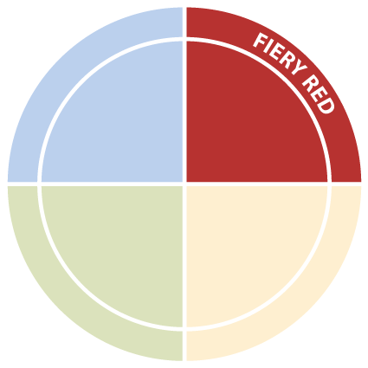


Match my style
You will be matched with a partner who leads with a different color energy.
Use your partner’s preferred energy(ies) to discuss the scenario
on the next slide.
After the conversation, provide feedback on whether the adaptation was effective, or what could have made it more effective.
Compare/contrast to your usual approach
Notes:
Optional Activity BREAKOUT ROOMS: (time permitting, and a session with fewer than 20 participants)
PRODUCER: Breakout rooms
Ahead of the session, identify partners that lead with different colour energies, or at least have different orders of colour energies.
At this point in the session, send partners to their breakout rooms with these two slides loaded into the rooms. Partners are to have the two conversations, practicing adapting to each other’s preferred colour energies, and then providing feedback to each other about what worked and what could have been more effective in the conversation.
Return to the main room and debrief together.

Slide 83
Match my style
Scenario 1: Let them know about a schedule change (change to a deadline) that impacts their work.
Change roles.
Scenario 2: Provide feedback about a recent presentation you saw them give.
Notes:
Optional Activity, slide 2

Slide 84
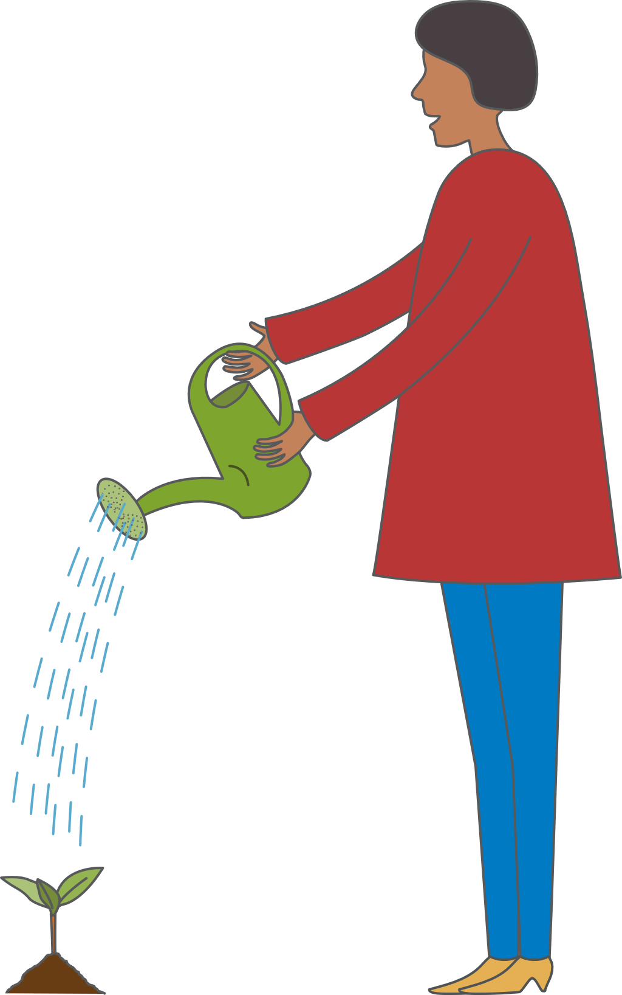
Personal development
We are what we repeatedly do.
Excellence then is not an act but a habit.
Notes:
Have a discussion with your participants about the need to develop the skill and habit to successfully adapt and connect better with others.

Slide 85
Your journey continues …
How will I adapt my behaviour?
What is my key action?
What did I discover about myself?
What do I appreciate about the styles of others?
Notes:
Remind participants about the person
PRODUCER: Text box
Ask participants to type into the box one action they will take based on what they learned in today’s session

Slide 86
Additional resources
Discovery Insightful Strategies Job Aid
Supports you to remember characteristics, communication tips and preferences of each of the colour energies
Colour block image
Add to your email signature to share your preferences digitally
Mini Reference Guide
Keep it handy as a reminder of key topics from today and for tips to adapt to connect
Notes:
Share the supporting materials participants have to takeaway.
They can review the eLearning module again
Insightful Strategies job aid
Colourful block image download
Mini Reference guide job aid
If you have specific homework or followup based on the learning objectives for this session, explain them here.

Slide 87
John Smith
jsmith@email.com
www.facebook.com/InsightsConnections
www.twitter.com/insights
Notes:
Thank the participants for their time and energy, and share the last slide
with your contact details in case they have any questions.
WELL DONE!

